Slide 1

Solar power: Social, environmental and economic concerns
Georgios Avgerinopoulos
gav@kth.se
Introductory lecture – Energy commodities and technologies
This work by OpTIMUS.community is licensed under the Creative Commons Attribution 4.0 International License. To view a copy of this license, visit http://creativecommons.org/licenses/by/4.0/.

Slide 2
Global trends
Solar power: overview
Economic concerns
Environmental concerns
Social concerns

Slide 3
Solar power: overview
Solar-thermally generated electricity:
Complex collectors to gather solar radiation to produce temperatures high enough to drive steam turbines to produce electric power.
For example, a turbine fed from parabolic trough collectors might take steam at 750 K and eject heat into atmosphere at 300 K will have a ideal thermal (Carnot) efficiency of about 60%. Realistic overall conversion (system) efficiency of about 35% is feasible.
Photovoltaic energy:
The direct conversion of sun’s rays to electricity.
The efficiency (the ratio of the maximum power output and the incident radiation flux) of the best single-junction silicon solar cells has now reached 46% in laboratory test conditions. The best silicon commercially available PV modules have an efficiency of about 20%.

Slide 4
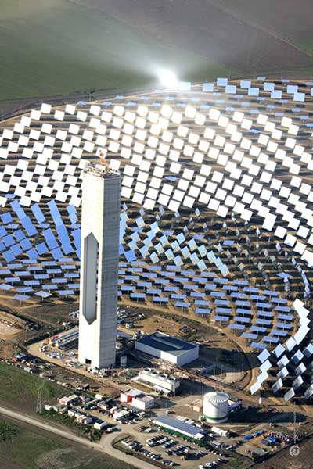
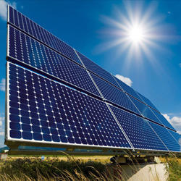
Solar power: overview
Solar Thermal – Concentrating Solar Power
Trough
Linear fresnel
Dish
Tower
Main types of PV’s
Crystalline silicon solar cells
Monocrystalline Si or polycrystalline
> 90% market share
Thin film solar cells
Amorphous Si
Polycrystalline CdTe, CIGS
< 10% market share
Emerging technologies
Concentrating PV
Electrochemical (dye sensitized, aka Gräetzel cells)
Organic solar cells

Slide 5
Solar power: overview
Theoretical: 1.76 x 105 TW striking Earth; 0.3 Global mean albedo.
Practical: 600 TW.
Intermittent source, reasonably predictable.
Solar thermal performs better than PV but also requires higher initial investments.

Slide 6
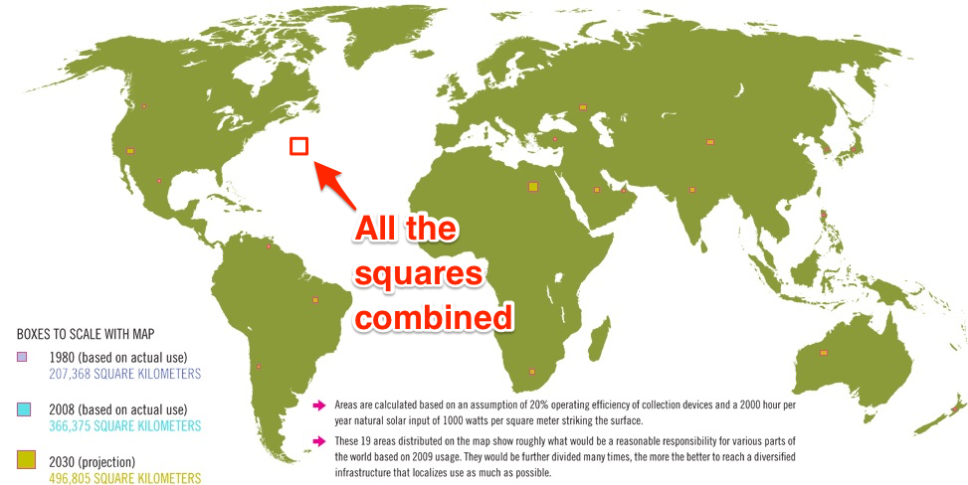
Solar power: overview

Slide 7
Solar power: environmental concerns
Use of toxic materials in cells & batteries
Cadmium
Arsenic
Hydrogen selenide gas
Intensity of manufacturing process
Si purity requirements high
Consumption of ultrapure water ca 10 m3/kWp
Fugitive losses of Heat Transfer Fluid (Solar thermal)
Venting of light decomposition product of HTF

Slide 8
Solar power: social concerns
Visual intrusion in rural and urban environments
Need for cooling installation/cooling water
Cooling water - scarce in regions where solar insolation is high (need for water conservation)
Water use for solar thermal plants is similar to amounts needed for a comparably sized coal or nuclear plants, but depends on the type of cooling tower (wet, wet-dry, dry)

Slide 9
Technologies in the solar chain
Photovoltaic (PV) and Concentrating Solar Power (CSP)

Slide 10


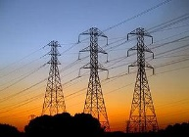
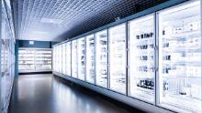
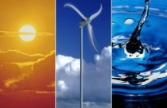
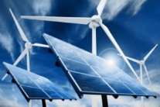
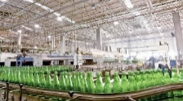
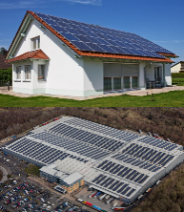
Sample Reference Energy System: solar
Energy demand
Transportation sector
Energy demand
Residential sector
Electricity transmission and distribution
Energy demand
Commercial sector
Centralised renewable
power plants
Electricity
Energy demand
Industrial sector
Decentralised energy supply
Sun
Heat
Notes:
Here we see the whole chain, but in this lecture we will focus on the electricity supply. We will not focus on the heat supply.

Slide 11
Centralised PV and CSP
Key characteristics
Utility PV
Capital cost | 1700-2100 $/kW
FOM cost | 1% of capital / year
VOM cost | 0 $/GJ
Life-cycle CO2 emission factor | 12-25 gCO2/kWh
Avg. capacity factor | 13%
Lifetime | 25 years
CSP (no storage)
Capital cost | 4500-8000 $/kW
FOM cost | 25-35 $/kW/a
VOM cost | 0 $/GJ
Efficiency | 13-15%
Avg. capacity factor | 25-28%
If the exact same (group of) solar power unit(s) is installed in different locations, the parameter that changes is the capacity factor.
In countries with good solar resources, PV has reached the so called grid-parity. In others, not yet competitive.
Most diffused commercial PV techs are wafer-based crystalline silicon and thin film. The latter is cheap (the production chain is similar to the one of LCD) but less efficient.
CSP not yet competitive, but potential if market increases.
Notes:
Grid-parity: the cost of generation equals the average cost of generation of the grid electricity. In other words, PV is in some cases competitive with the base load generation by fossil fuels.
PV emissions: occurring during manufacturing only

Slide 12
Centralised PV and CSP
If the exact same (group of) solar power unit(s) is installed in different locations, the parameter that changes is the capacity factor.
In countries with good solar resources, PV has reached the so called grid-parity. In others, not yet competitive.
Most diffused commercial PV techs are wafer-based crystalline silicon and thin film. The latter is cheap (the production chain is similar to the one of LCD) but less efficient.
CSP not yet competitive, but potential if market increases.
Key characteristics
Residential PV
Capital cost | 2200-4500 $/kW
FOM cost | 1% of capital / year
VOM cost | 0 $/GJ
Life-cycle CO2 emission factor | 12-25 gCO2/kWh
Avg. capacity factor | 13%
Lifetime | 25 years
Notes:
For the residential systems (e.g. rooftop PV), the capital cost is higher.

Slide 13
References and reading material

Slide 14
IEA, World Energy Outlook 2016;
European Commission, Joint Research Centre, Energy Technology Reference Indicators (ETRI) 2014. Available at: https://setis.ec.europa.eu/sites/default/files/reports/ETRI-2014.pdf;
IEA, NEA, Projected Costs of Generating Electricity 2015. Available at: https://www.oecd-nea.org/ndd/pubs/2015/7057-proj-costs-electricity-2015.pdf;
IEA-ETSAP, Energy Technology Data Source. Available at: https://iea-etsap.org/index.php/energy-technology-data;

Slide 15
Sources for the RES pictures
Gasification: http://www.gbgasifired.com/model.html
Extraction: http://www.energytrendsinsider.com/research/coal/coal-mining-and-processing/
Refinery: http://stillwaterassociates.com/crack-spread-a-quick-and-dirty-indicator-of-refining-profitability/
Biomass: http://inhabitat.com/tag/biomass/
Renewables: http://www.topnews.in/wind-water-and-sun-beat-biofuels-nuclear-and-coal-clean-energy-297577
Uranium: http://unitednuclear.com/index.php?main_page=product_info&products_id=1028
Fossil: https://www.slideshare.net/MMoiraWhitehouse/fossil-fuels-teach
Combustion based power plants: https://en.wikipedia.org/wiki/Battersea_Power_Station_in_popular_culture
Uranium enrichment: http://energyfromthorium.com/2010/08/06/loveswu1/
Residential: http://jhsimpson.com/residential/
Transport: https://se.123rf.com/clipart-vektorer/transport.html
Industry: http://indianexpress.com/article/business/economy/factory-output-grows-2-per-cent-in-february-after-3-months-of-contraction/
Commercial: http://www.alfalaval.com/industries/refrigeration/commercial-refrigeration/
Transportation of fuel: http://www.zerohedge.com/news/2017-06-23/demand-oil-pipeline-capacity-hits-6-year-low
Transportation of biomass: http://www.forestenergy.ie/transportation-studies.php
Transportation of oil products: http://www.picquery.com/gasoline-truck_WXRZaplkZ2eaRVifu*zjqPAvrMnnxmBsTSgdn*BBBKk/

Slide 16
Sources for the RES pictures
Decentralized energy supply: http://trayamtechnologies.com/solar-pv-roof-top-and-ground-mounting/
Decentralized energy supply2: http://www.sunwindenergy.com/photovoltaics/38-mw-rooftop-pv-system-completed-uk
Biogas and bio-synthetic gas production: https://ehp.niehs.nih.gov/123-a180/
Onshore wind: https://www.mitchelltech.edu/programs/on-campus/energy-production-transmission/wind-turbine-technology
Offshore wind: http://inhabitat.com/tag/offshore-wind-farm/
Solar tower: http://www.power-technology.com/projects/seville-solar-tower/seville-solar-tower1.html
PV panels: https://dir.indiamart.com/coimbatore/solar-pv-panel.html
Solar power area requirements: http://forums.mwerks.com/showthread.php?7477561-Global-Energy-Thread
Bioenergy conversion: http://14.139.172.204/nptel/CSE/Web/103102022/environmental%20issues%20and%20new%20trends/ecological%20consideration%20in%20petroleum%20refinery.html

Slide 17
Changelog and attribution
Date | Author | Reviewer | Reviser
2017-09-26 | Georgios Avgerinopoulos | Mark Howells | Georgios Avgerinopoulos
To correctly reference this work, please use the following:
Avgerinopoulos, G., 2017. Solar power: Social, environmental and economic concerns, OpTIMUS.community. Available at: http://www.osemosys.org/understanding-the-energy-system.html. [Access date]

